Slide 1
IBM Applied Data Science Capstone Project
Patricia Wheelis
April 6, 2026

Slide 2
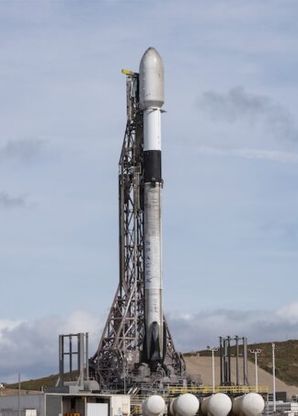
Outline
Executive Summary
Introduction
Methodology
Results
Conclusion
Appendix
Photo credit: https://www.spacelaunchschedule.com/wp-content/uploads/2026/02/20240214_Starlink_7-14_prelaunch_small-678x452-9.jpg

Slide 3
Executive Summary
Summary of Methodologies
Data collection and wrangling
Data analysis
Data visualization
Machine learning prediction
Summary of Results
Exploratory data analysis results
Interactive analysis demo in screenshots
Predictive analysis results

Slide 4
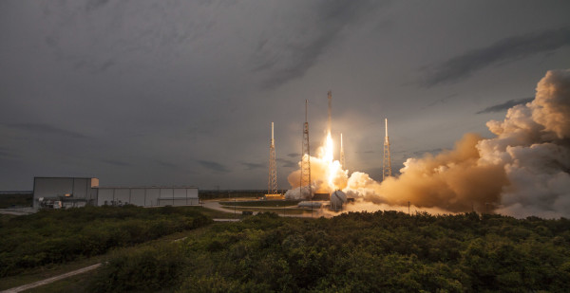
Introduction
This Photo by Unknown Author is licensed under CC BY-NC
SpaceX advertises Falcon 9 rocket launches on its website with a cost of 62 million dollars while other providers cost upward of 165 million dollars. Much of the savings is because SpaceX can reuse the first stage. Therefore if we can determine if the first stage will land, we can determine the cost of a launch. Based on public information and machine learning models, we are going to predict if SpaceX will reuse the first stage.
Questions to be answered
How do variables such as payload mass, launch site, number of flights, and orbits affect the success of the first stage landing?
Does the rate of successful landings increase over time?
What is the best algorithm to be used for binary classification in this case?

Slide 5
Methodology

Slide 6
Methodologies
Data collecting and wrangling
Collecting: SpaceX API, Web scraping
Wrangling: Apply filters, address missing values, use one-hot encoding to encode categorical features
Exploratory data analysis (EDA)
Pandas and NumPy
SQL
Matplotlib and Seaborn
Folium
Dash
Machine learning prediction
Logistic regression
Support vector machine (SVM)
Decision tree
K-nearest neighbors (KNN)

Slide 7
Methodology 1 Data Collecting
Flowchart of steps taken in data collection using API
Request rocket launch data from SpaceX API
Use JSON to decode response content
Build dictionary from obtained data and create dataframe from dictionary
Filter data to include only Falcon 9 launch information
Replace missing values in Payload Mass column with calculated mean for that column and export to CSV
Github: Data Collection

Slide 8
Methodology 1 Data Collecting
Request Falcon 9 launch data from Wikipedia
Collect the data by parsing HTML tables
Build dictionary from obtained data
Create dataframe from dictionary
Export to CSV
Flowchart of steps taken in data collection using Web Scraping
Github: Web Scraping

Slide 9
Methodology 1 Wrangling
Wrangling and Formatting
Perform exploratory data analysis
Calculate number of launches per site
Calculate number and occurrence of each orbit
Calculate number and occurrence of mission outcome per orbit type
Add column ‘Class’ classifying 0 if a launch is failed and 1 if it is successful
Github: Data Wrangling

Slide 10
Methodology 2 Exploratory Data Analysis (EDA)
Python Libraries
Pandas and NumPy
Functions from the pandas and NumPy libraries are used to plot charts to determine relationships between variables:
The number of launches on each launch site
The number and occurrence of each orbit
The number and occurrence of each mission outcome
Matplotlib and Seaborn
Functions from the Matplotlib and Seaborn libraries are used to visualize the findings with scatterplots, bar charts, and line charts.
The plots and charts are used to understand more about the relationships between several features, such as:
The relationship between flight number and launch site
The relationship between payload mass and launch site
The relationship between success rate and orbit type
Github: EDA Visualization

Slide 11
Methodology 2 Exploratory Data Analysis (EDA)
Python Libraries
FOLIUM
Functions from the Folium libraries are used to visualize the data through interactive maps, including:
Mark all launch sites on a map
Successful and failed launches for each site
Distances between a launch site and locations as the nearest city, railway, or highway
Github: Site Location Folium
Dash
Functions from Dash are used to generate an interactive site with input toggled through a dropdown menu and a range slider
Using a pie chart and a scatterplot, the interactive site shows:
The total success launches from each launch site
The correlation between payload mass and mission outcome (success or failure) for each launch site
Github: Dash

Slide 12
Methodology 2 Exploratory Data Analysis (EDA)
SQL
The data is queried using SQL to answer several questions including:
The names of the unique launch sites in the space mission
Displaying 5 records of Launch Site names that begin with CCA
The total payload mass carried by boosters launched by NASA (CRS)
The average payload mass carried by booster version F9 v1.1
Total number of successful and failed mission outcomes
Names of the booster versions which have carried the maximum payload mass
Date of first successful landing outcome in ground pad
Names of boosters which have success in drone landings with payload mass between 4000-6000
Count of landing outcomes between the dates 2010-06-04 and 2017-03-20
Failed landing outcomes in drone ship with their booster versions and launch site names in 2015
Github: SQL

Slide 13
Methodology 3 Predictive Analysis
Functions from the Scikit-learn library are used to create our machine learning models.
The machine learning prediction phase includes the following steps:
Standardizing the data
Splitting the data into training and test data
Creating machine learning models, which include:
Logistic regression
Support vector machine (SVM)
Decision tree
K nearest neighbors (KNN)
Fit the models on the training set
Find the best combination of hyperparameters for each model
Evaluate the models based on their accuracy scores and confusion matrix
Github: Machine Learning Predictions

Slide 14
Results
Exploratory data analysis results
Interactive analytics demo in screenshots

Slide 15
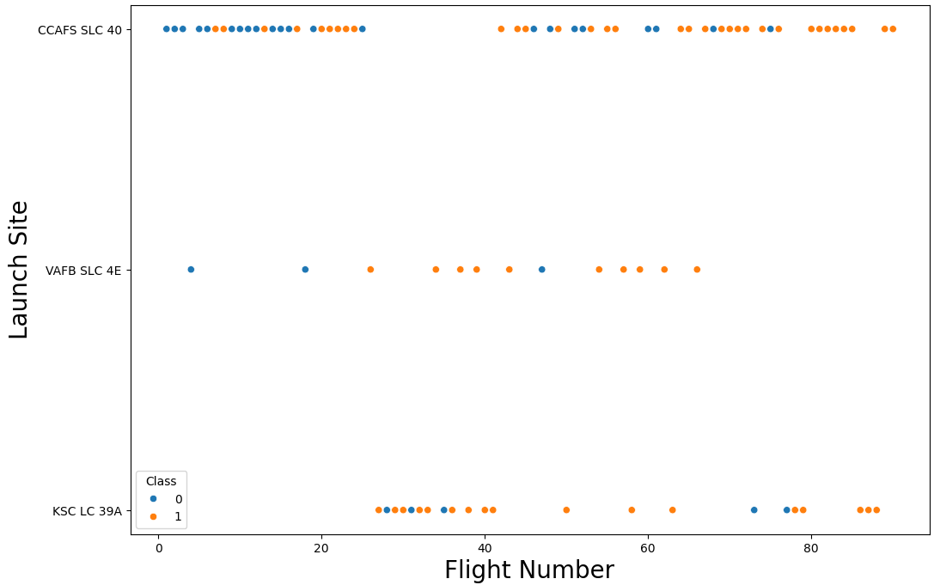
EDA with Visualization
Flight Number vs Launch Site (Class 0 – Failed, Class 1 – Successful)
Explanation
The CCAFS SLC 40 launch site has about a half of all launches, but the VAFB SLC 4E and KSC LC 39A launch sites appear to have higher success rates.
Earliest flights failed while latest flights succeeded, leading to the conclusion that each new launch has a higher rate of success.

Slide 16
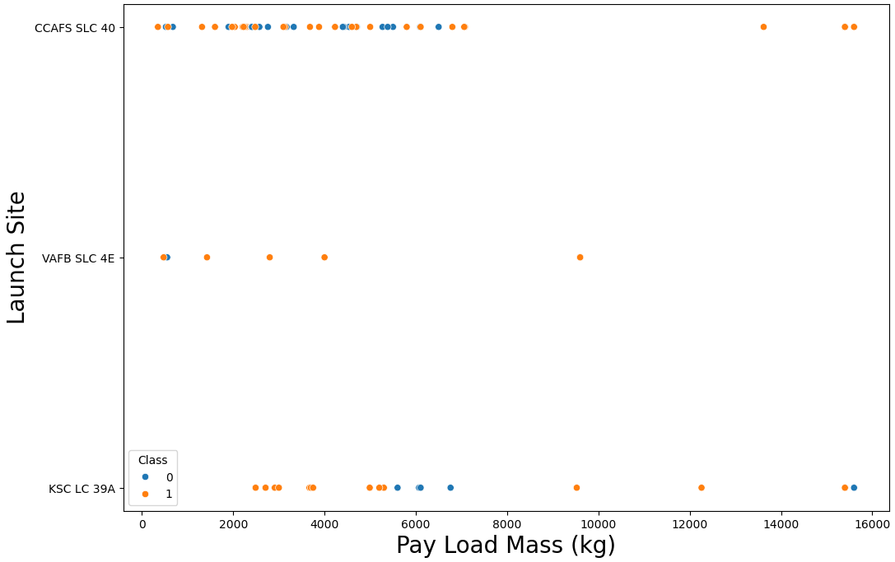
EDA with Visualization
Payload Mass vs Launch Site (Class 0 – Failed, Class 1 – Successful)
Explanation
Launch site KSC LC 39A has a 100% success rate for payload mass under 5500 kg.
Most of the launches with a payload mass over 7000 kg were successful.
At each launch site the higher the payload mass the higher the success rate.

Slide 17
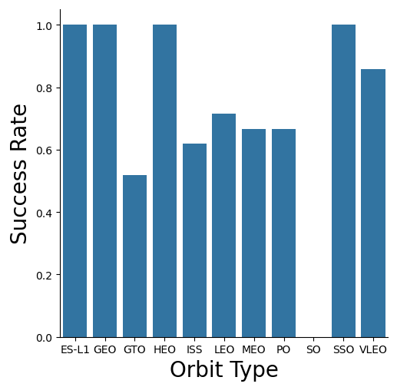
EDA with Visualization
Success Rate vs Orbit Type
Explanation
Orbits with 100% success rate
ES-L1
GEO
HEO
SSO
Orbits with success rate between 50% and 85%
GTO
ISS
LEO
MEO
PO
Orbits with 0% success rate
SO

Slide 18
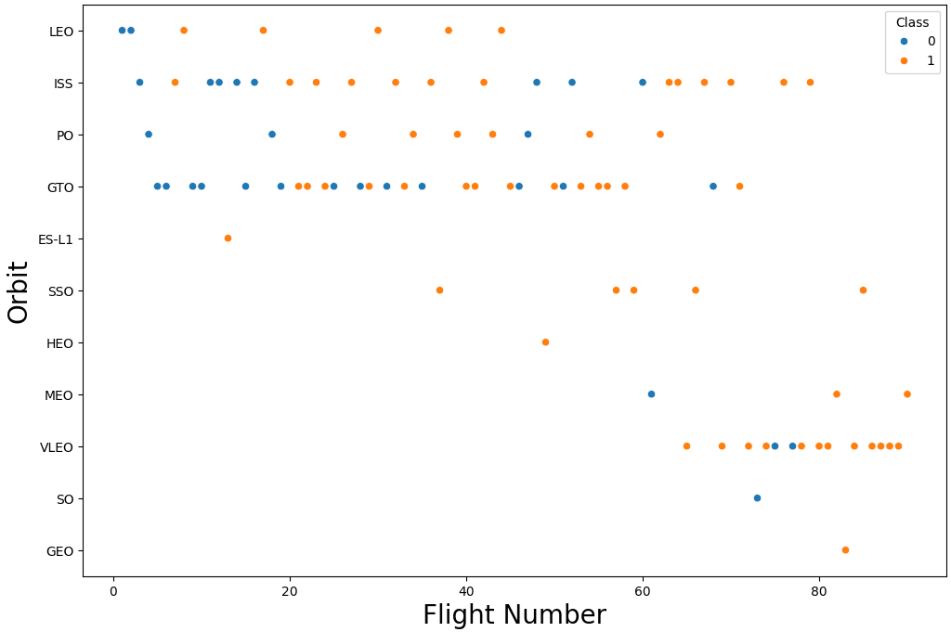
EDA with Visualization
Flight Number vs Orbit Type (Class 0 – Failed, Class 1 – Successful)
Explanation
In the LEO Orbit success appears to be related to the number of flights.
In the GTO orbit there does not appear to be a relationship between success and the number of flights.

Slide 19
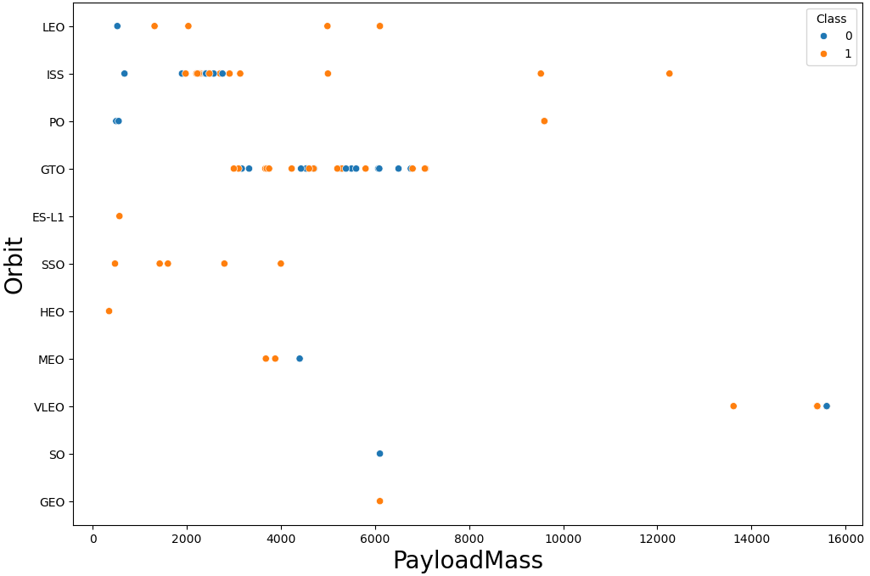
EDA with Visualization
Payload Mass vs Orbit Type (Class 0 – Failed, Class 1 – Successful)
Explanation
Heavy loads appear to be more favorable for Polar, LEO, and ISS orbits.
For GTO orbit it's difficult to distinguish between successful and failed landings as both outcomes are present.

Slide 20
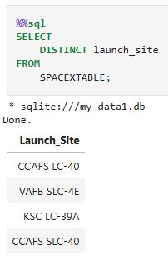
EDA with SQL
Displaying the Unique Launch Sites using an SQL query

Slide 21
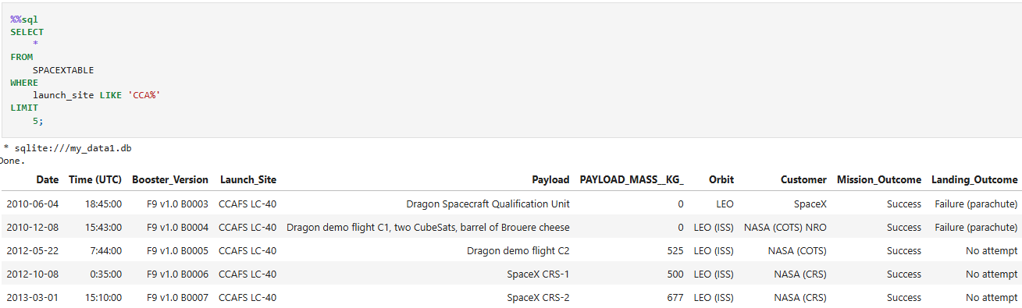
EDA with SQL
Displaying 5 records of Launch Site names that begin with CCA using an SQL query

Slide 22
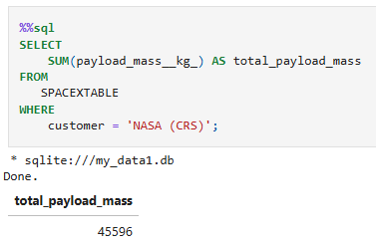
EDA with SQL
Displaying Total Payload Mass carried by boosters from NASA using an SQL query

Slide 23
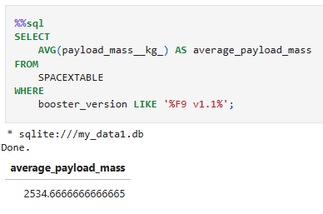
EDA with SQL
Displaying Average Payload Mass carried by booster version F9 v1.1 from NASA using an SQL query

Slide 24
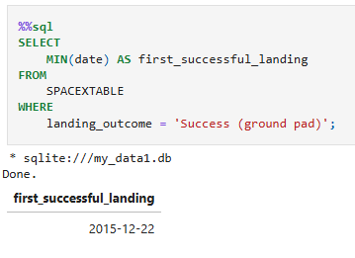
EDA with SQL
Displaying first successful ground landing date using an SQL query

Slide 25
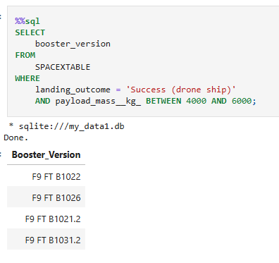
EDA with SQL
Displaying Successful Drone Ship Landing with Payload between 4000 and 6000 using an SQL query

Slide 26
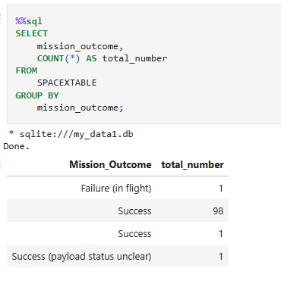
EDA with SQL
Displaying total number of successful and failure mission outcomes using an SQL query

Slide 27
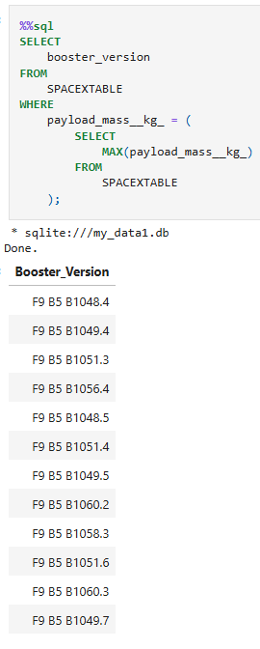
EDA with SQL
Displaying names of the booster which have carried the maximum payload mass using an SQL query

Slide 28
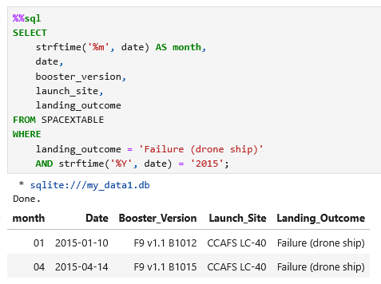
EDA with SQL
Displaying failed landing outcomes in drone ship with their booster versions and launch site names in 2015 using an SQL query

Slide 29
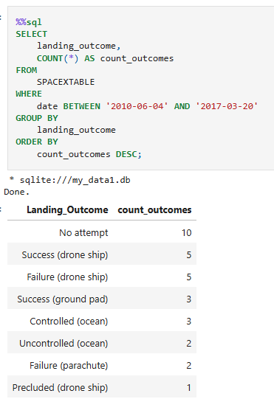
EDA with SQL
Displaying the count of landing outcomes between the dates 2010-06-04 and 2017-03-20 in descending order using an SQL query

Slide 30
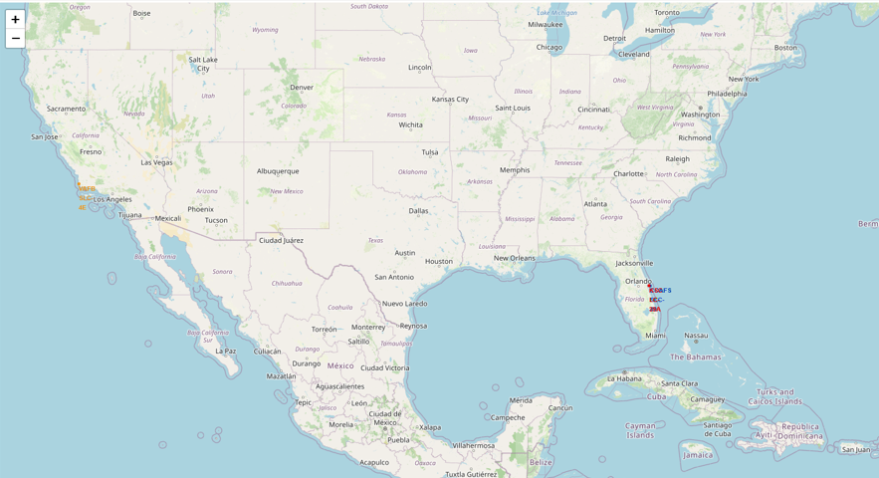
All launch location markers on global map with Folium
Most of the launch sites are in proximity to the Equator to take advantage of the increased rotational velocity and low-inclination and geostationary orbits.
They are also more concentrated along coastlines to minimize risk and simplify recovery of hardware. Proximity to the ocean lets recovered boosters return to nearby drone ships or landing zones quickly.

Slide 31
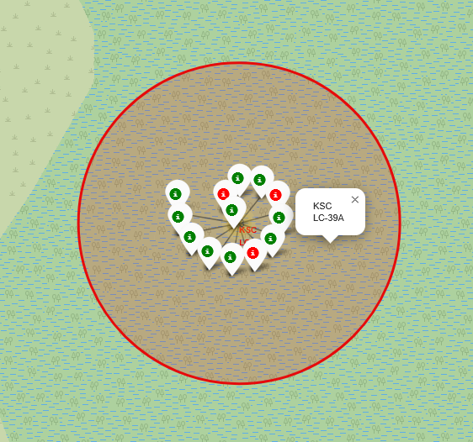
Color Labeled Launch records on map with Folium
Using color labels to mark launches allows us to easily identify which launch sites have relatively high success rates.
Green Markers indicate successful launches
Red Markers indicate failed launches
As shown in the image, Launch Site KSC LC-39A has a high success rate.

Slide 32
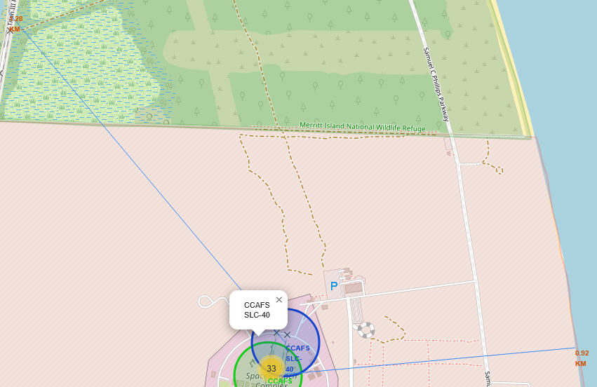
Distance from Launch Site CCAFS SLC-40 to Proximities on map with Folium
From the visual analysis of the launch site CCAFS SLC-40 we can determine the following:
Closest Railway: 1.28 km
Closest Highway: 0.83 KM
Closest City: 13.06 km

Slide 33
Dashboard with Plotly Dash
The dashboard is comprised of two plots
Pie Chart showing launch successes and failures
Interactive dropdown menu enables toggling through all sites
Allows quick visual assessments and comparisons of landing outcomes by launch site
Scatter Plot showing payload mass vs. landing outcome using colors to distinguish booster versions
Dropdown menu offers the same interactivity as the pie chart
Additional slider allows filtering by payload range data

Slide 34
Predictive Analysis (Classification)

Slide 35
Predictive Analysis using Machine Learning
Four Machine Learning Classifications models were constructed using this process to predict landing outcome
Logistic Regression
Support Vector Machine
Decision Tree
K-Nearest Neighbor
Standardize
Standardize the data using
transform = preprocessing.StandardScaler()
X = transform.fit(X).transform(X)
Split
Split the data into training and test data using
X_train, X_test, Y_train, Y_test = train_test_split( X, Y, test_size=0.2, random_state=2)
Create and Optimize
Create model object and parameters dictionary using
parameters ={"C":[0.01,0.1,1],'penalty':['l2'], 'solver':['lbfgs']}# l1 lasso l2 ridge
lr=LogisticRegression()
logreg_cv = GridSearchCV(lr, parameters, cv=10)
Train
Train the model using
logreg_cv.fit(X_train, Y_train)
Evaluate
Evaluate the accuracy of the model using
lr_optimized = LogisticRegression(C=0.1, penalty='l2', solver='lbfgs').fit(X_train, Y_train)
lr_score = lr_optimized.score(X_test, Y_test)
print('Accuracy Score: {}' .format(lr_score))

Slide 36
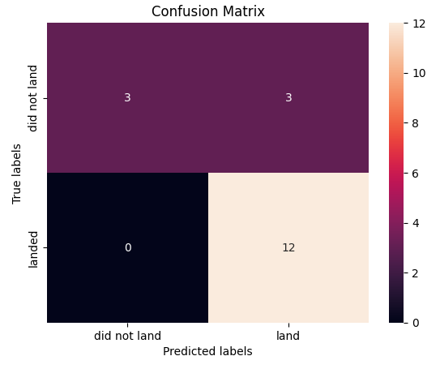
Confusion Matrix
All four models had the same The confusion Matrix and similar accuracy scores
18 outcomes were predicted and each had 3 false positives.

Slide 37
Conclusion
Landing outcome of the first stage rocket can be predicted with 83.34% accuracy
Variables affecting landing outcome
Launch site: Geography plays an important role. Launch sites should be as close to the equator and a coastline as possible
Launch number: More launches lead to more experience and higher success rates
Payload: Heavier payloads tend to have more failed launches

Slide 38
Appendix
GitHub link to main repository
https://github.com/pwheelis/IBM-Applied-Data-Science-Capstone/tree/main

